Slide 1
List to go

Slide 2
Table of Contents
01
The Website
03
Architecture
02
Technology
04
Future Goals
Brief explanation of the website
A Talk about architecture of website
Technology used during the website
Future plans for team

Slide 3
01
Website

Slide 4
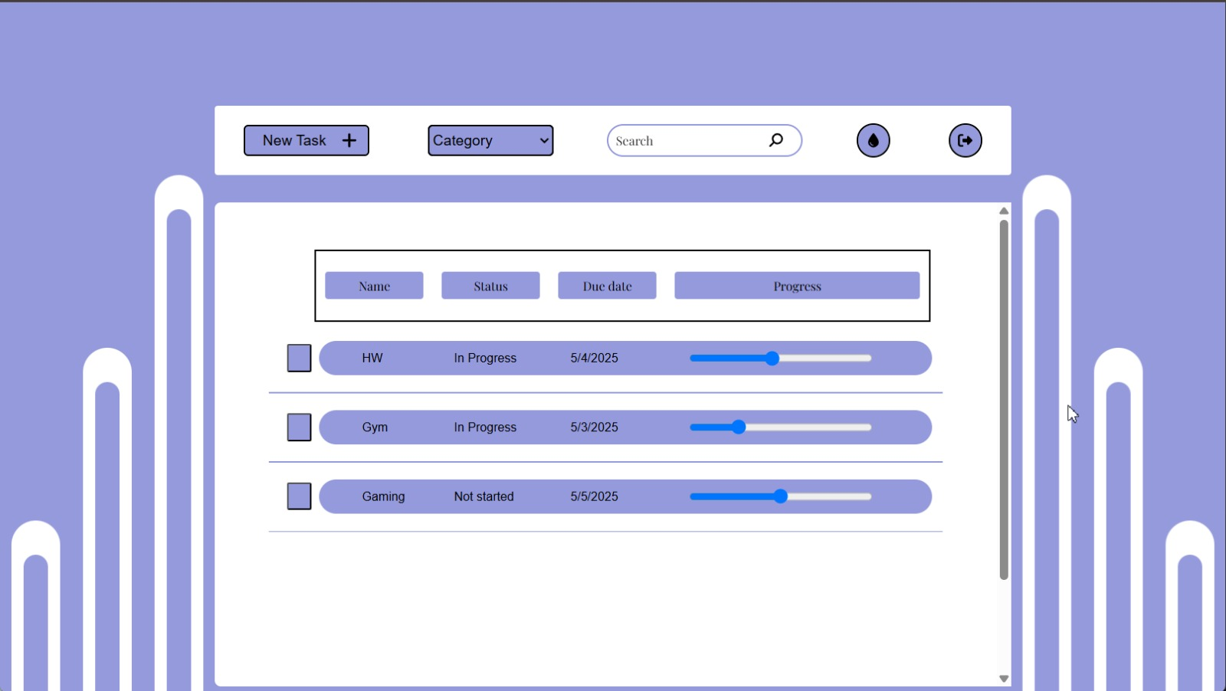

Slide 5
Features of Application
Task manage
Password reset
Managing tasks edit or delete
Can reset password if we forget it
Task Creation
User Auth
Searching &filtering
Creating Tasks
Login view for users
Can search for specific task

Slide 6
02
Technology

Slide 7
Technology used
Backend
Frontend
Database
Django is framework for python that work with APIs to interact with frontend
React as client side of website that has UI for users to view
MySQL for saving data in order structure for users and their tasks

Slide 8
Architecture of Website
Models
Forms
Django code
Urls
Views

Slide 9
03
Architecture

Slide 10
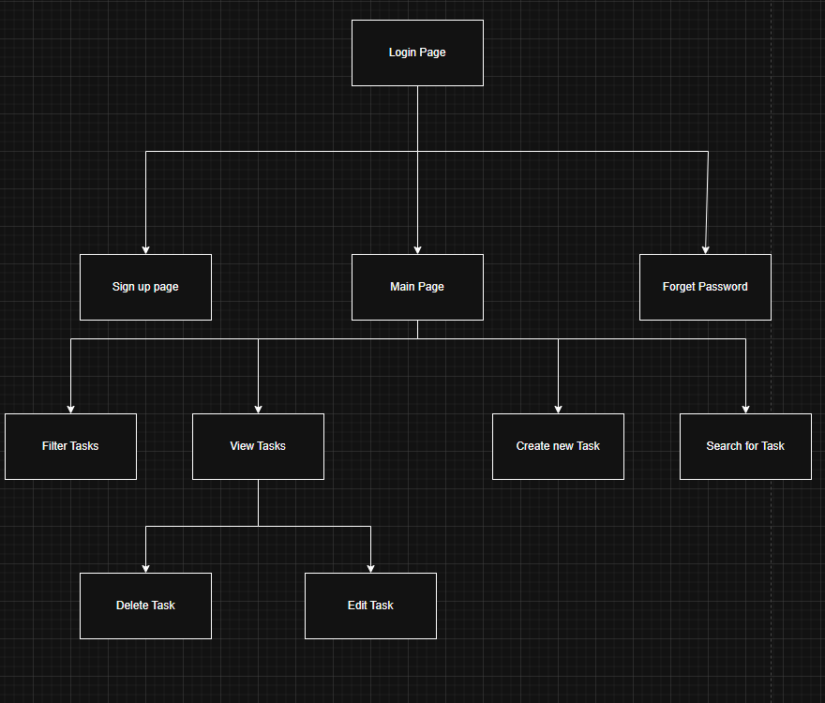

Slide 11
Architecture Frontend
Use effect
gsap
Use state
Functions

Slide 12

Future Plans

Slide 13
Thanks!
Any Questions?

